Slide 1
Operating System
OS Concepts

Slide 2
What are OS?
Why are OS needed?
How are OS designed and implemented?

Slide 3
Operating System
An OS is a layer of system software that
Directly has privileged access to underlying hardware
Hides the hardware complexity
Manages hardware on behalf of one or more applications according to some pre-defined polices
In addition it ensures that the applications are isolated and protected from one another

Slide 4
Working of Operating System
OS hides the hardware complexity
Storage (Read/Write Files)
Network (Send/Receive sockets)
Resource Management (OS allocates memory for apps)
CPU Scheduling
Provide Isolation and protection

Slide 5
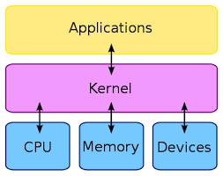
Kernal
Kernal is a computer program at the core of computer operating system and has complete control over everything in the system

Slide 6
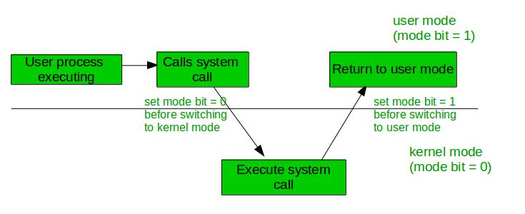
Kernal Mode and User Mode
User Mode is normal mode where the process has limited access
Kernal mode is the privileged mode where the process has unrestricted access to the system resources like h/w, memory etc.

Slide 7
System Call
In computing, a system call is a programmatic way in which a computer program requests a service from the kernel of the operating system on which it is executed.
Types of system call
Process Control
Create Process, terminate process
File Management
Create/Delete file
Open/Close file
Read/Write File

Slide 8
Cont…
Device Management
Request device, release device
Get/Set device attributes
Information Management
Get/Set total system information
Get/Set process, file or device metadata
Communication
Create/Delete communication connections
Send/Receive messages
Transfer status information
Protection
Get/Set file permission

Slide 9
Computer Start up
bootstrap program is loaded at power-on or reboot
Typically stored in ROM or EPROM, generally known as firmware
Initializes all aspects of system
Loads operating system kernel and starts execution

Slide 10
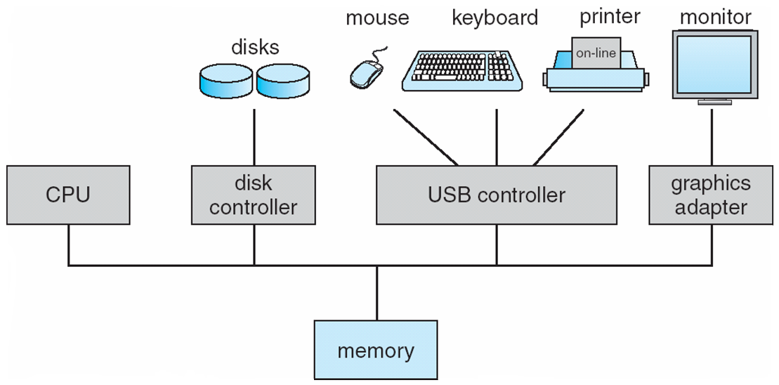
Computer System Organization
Computer-system operation
One or more CPUs, device controllers connect through common bus providing access to shared memory
Concurrent execution of CPUs and devices competing for memory cycles

Slide 11
Computer System Operations
I/O devices and the CPU can execute concurrently
Each device controller is in charge of a particular device type
Each device controller has a local buffer
CPU moves data from/to main memory to/from local buffers
I/O is from the device to local buffer of controller
Device controller informs CPU that it has finished its operation by causing an interrupt

Slide 12
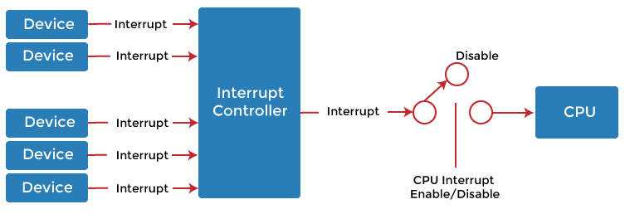
Interrupt
An interrupt is a signal emitted by hardware or software when a process or an event needs immediate attention. It alerts the processor to a high-priority process requiring interruption of the current working process.

Slide 13
Functions of Interrupt
Interrupt transfers control to the interrupt service routine generally, through the interrupt vector, which contains the addresses of all the service routines
Interrupt architecture must save the address of the interrupted instruction
Incoming interrupts are disabled while another interrupt is being processed to prevent a lost interrupt
A trap is a software-generated interrupt caused either by an error or a user request
An operating system is interrupt driven

Slide 14
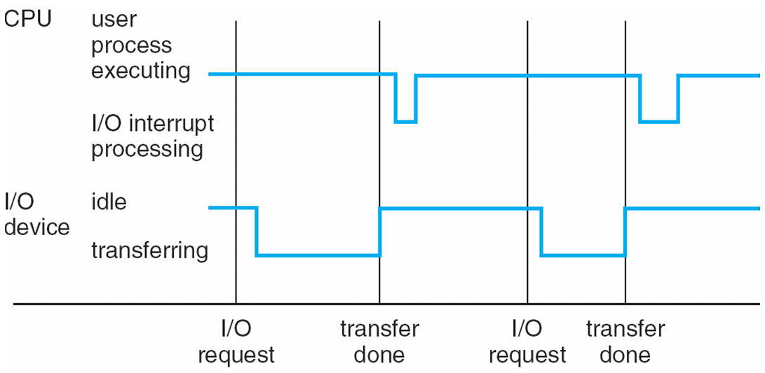
Interrupt Timeline

Slide 15
I/O Structure
After I/O starts, control returns to user program only upon I/O completion
Wait instruction idles the CPU until the next interrupt
No simultaneous I/O processing
After I/O starts, control returns to user program without waiting for I/O completion
System call – request to the operating system to allow user to wait for I/O completion
Device-status table contains entry for each I/O device indicating its type, address, and state
Operating system indexes into I/O device table to determine device status and to modify table entry to include interrupt

Slide 16
Storage Structure
Main memory – only large storage media that the CPU can access directly
Random access
Typically volatile
Secondary storage – extension of main memory that provides large nonvolatile storage capacity
Magnetic disks – rigid metal or glass platters covered with magnetic recording material
Disk surface is logically divided into tracks, which are subdivided into sectors
The disk controller determines the logical interaction between the device and the computer

Slide 17
Storage Hierarchy
Storage systems organized in hierarchy
Speed
Cost
Volatility
Caching – copying information into faster storage system; main memory can be viewed as a cache for secondary storage
Buffer Storage
A buffer is a data area shared by hardware devices or program processes that operate at different speeds or with different sets of priorities.
The buffer allows each device or process to operate without being held up by the other

Slide 18
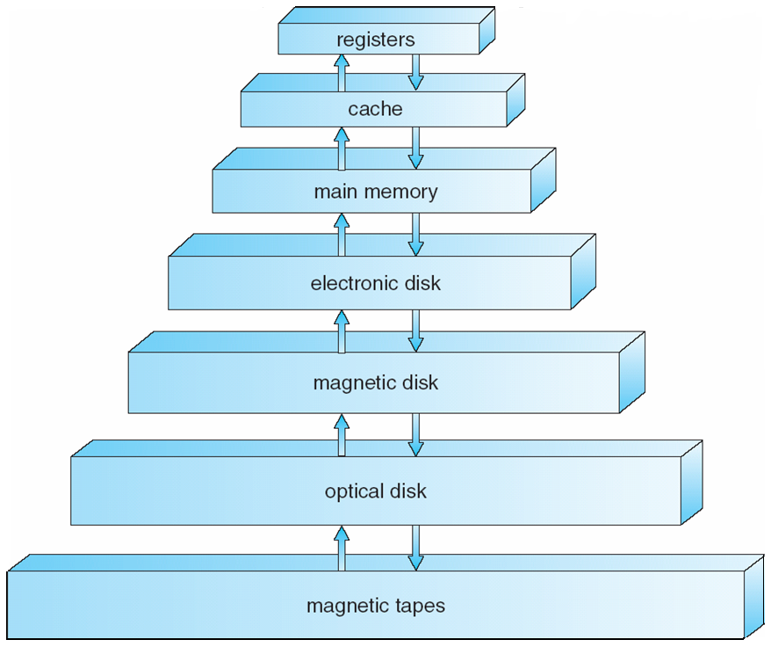
Storage Hierarchy

Slide 19
System Buses
A bus is a high-speed internal connection.
Buses are used to send control signals and data between the processor and other components.
Three types of bus are used.
Address bus - carries memory addresses from the processor to other components such as primary storage and input/output devices. The address bus is unidirectional.
Data bus - carries the data between the processor and other components. The data bus is bidirectional.
Control bus - carries control signals from the processor to other components. The control bus also carries the clock's pulses. The control bus is unidirectional.

Slide 20
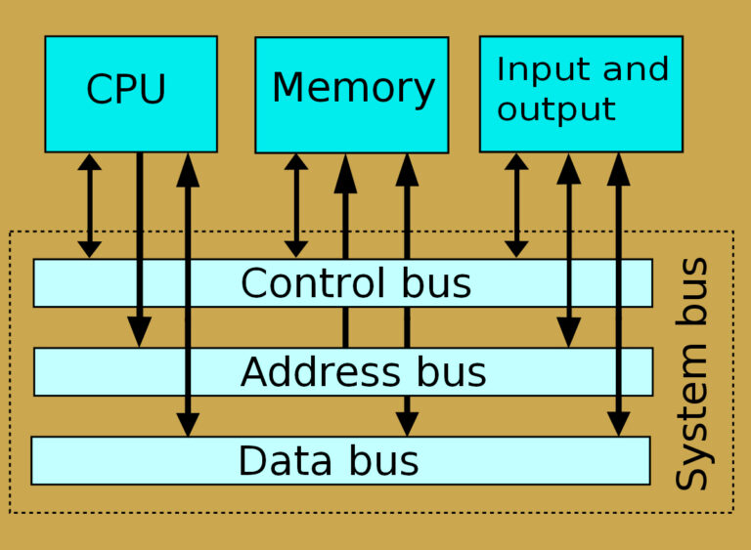
System Bus

Slide 21
Direct Memory Access Structure
Used for high-speed I/O devices able to transmit information at close to memory speeds
Device controller transfers blocks of data from buffer storage directly to main memory without CPU intervention
Only one interrupt is generated per block, rather than the one interrupt per byte

Slide 22
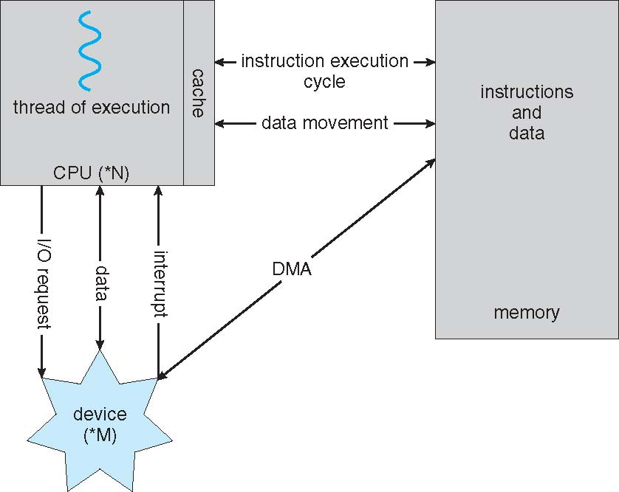
Computer System Architecture

Slide 23
Cont…
Single Processor Systems
Such as I/O processors special purpose processor run a limited instructions set and don't run user processes
E.g Disk controller micro processor receives a sequence of requests from the CPU and implement its own disk queue and scheduling algorithms
Multiprocessors systems growing in use and importance
Also known as parallel systems, tightly-coupled systems
Advantages include:
Increased throughput
Economy of scale
Increased reliability – graceful degradation or fault tolerance
Two types:
Asymmetric Multiprocessing (Each processor is assigned a specific task)
Symmetric Multiprocessing (Each processor performs all task with in OS)

Slide 24
Cont…
Clustered System
Like multiprocessor systems, but multiple systems working together
Usually sharing storage via a storage-area network (SAN)
Provides a high-availability service which survives failures
Asymmetric clustering has one machine in hot-standby mode
Symmetric clustering has multiple nodes running applications, monitoring each other
Some clusters are for high-performance computing (HPC)
Applications must be written to use parallelization

Slide 25
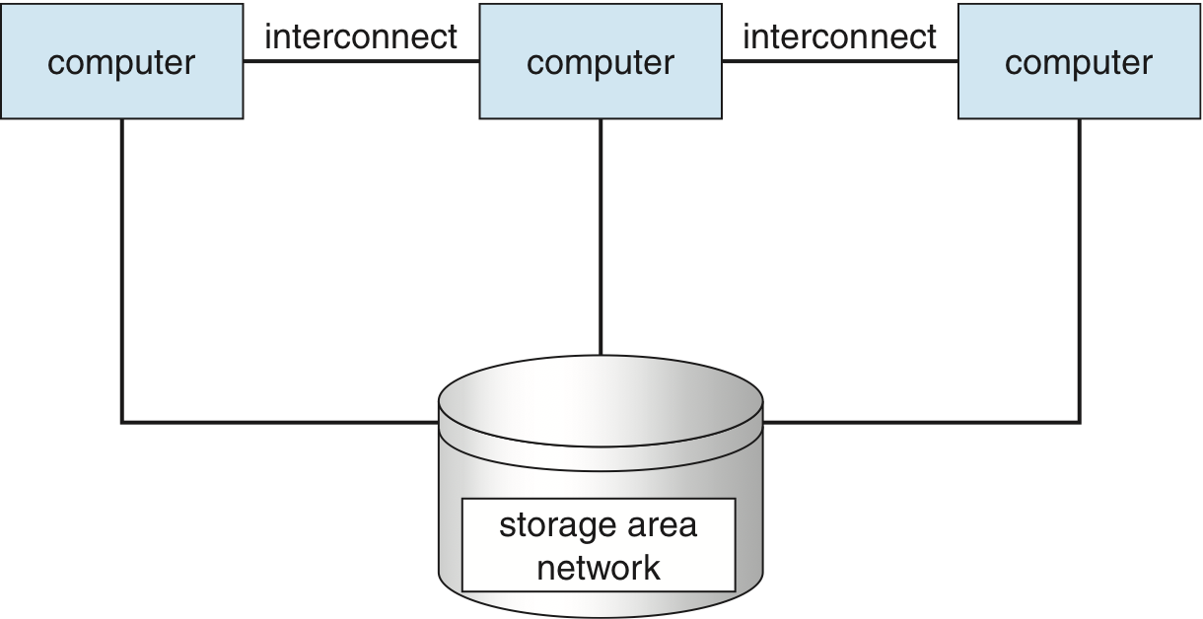
Clustered Systems

Slide 26
Operating System Structure
Multiprogramming needed for efficiency
Single user cannot keep CPU and I/O devices busy at all times
Multiprogramming organizes jobs (code and data) so CPU always has one to execute (as a busy lawyer)
A subset of total jobs in system is kept in memory
One job selected and run via job scheduling
When it has to wait (for I/O for example), OS switches to another job
Timesharing (multitasking) is logical extension in which CPU switches jobs so frequently that users can interact with each job while it is running, creating interactive computing
Response time should be < 1 second
Each user has at least one program executing in memory process
If several jobs ready to run at the same time  CPU scheduling
If processes don’t fit in memory, swapping moves them in and out to run
Virtual memory allows execution of processes not completely in memory

Slide 27
Process Management
A process is a program in execution. It is a unit of work within the system. Program is a passive entity, process is an active entity.
Process needs resources to accomplish its task
CPU, memory, I/O, files
Initialization data
Process termination requires reclaim of any reusable resources
Single-threaded process has one program counter specifying location of next instruction to execute
Process executes instructions sequentially, one at a time, until completion
Multi-threaded process has one program counter per thread
Typically system has many processes, some user, some operating system running concurrently on one or more CPUs
Concurrency by multiplexing the CPUs among the processes / threads

Slide 28
Memory Management
All data in memory before and after processing
All instructions in memory in order to execute
Memory management determines what is in memory
Optimizing CPU utilization and computer response to users
Memory management activities
Keeping track of which parts of memory are currently being used and by whom
Deciding which processes and data to move in and out of memory
Allocating and de-allocating memory space as needed

Slide 29
Storage Management
OS provides uniform, logical view of information storage
Abstracts physical properties to logical storage unit - file
Each medium is controlled by device (i.e., disk drive, tape drive)
Varying properties include access speed, capacity, data-transfer rate, access method (sequential or random)
File-System management
Files usually organized into directories
Access control on most systems to determine who can access what
OS activities include
Creating and deleting files and directories
Primitives to manipulate files and dirs
Mapping files onto secondary storage
Backup files onto stable (non-volatile) storage media

Slide 30
I/O Sub System
One purpose of OS is to hide peculiarities of hardware devices from the user
I/O subsystem responsible for
Memory management of I/O including buffering (storing data temporarily while it is being transferred), caching (storing parts of data in faster storage for performance), spooling (the overlapping of output of one job with input of other jobs)
General device-driver interface
Drivers for specific hardware devices

Slide 31
Protection and Security
Protection – any mechanism for controlling access of processes or users to resources defined by the OS
Security – defense of the system against internal and external attacks
Huge range, including denial-of-service, worms, viruses, identity theft, theft of service
Systems generally first distinguish among users, to determine who can do what
User identities (user IDs, security IDs) include name and associated number, one per user
User ID then associated with all files, processes of that user to determine access control
Group identifier (group ID) allows set of users to be defined and controls managed, then also associated with each process, file
Privilege escalation allows user to change to effective ID with more rights (setuid command)

Slide 32
Special Purpose Systems
Real-time embedded systems most prevalent form of computers
Vary considerable, special purpose, limited purpose OS, real-time OS
Multimedia systems
Handheld systems
PDAs, smart phones, limited CPU, memory, power
Reduced feature set OS, limited I/O

